Slide 1
EQ2401 Project 2
Yijie Li yijiel@kth.se

Slide 2
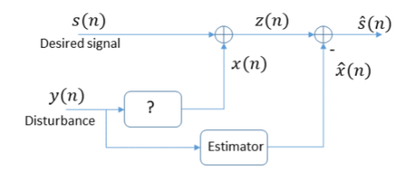

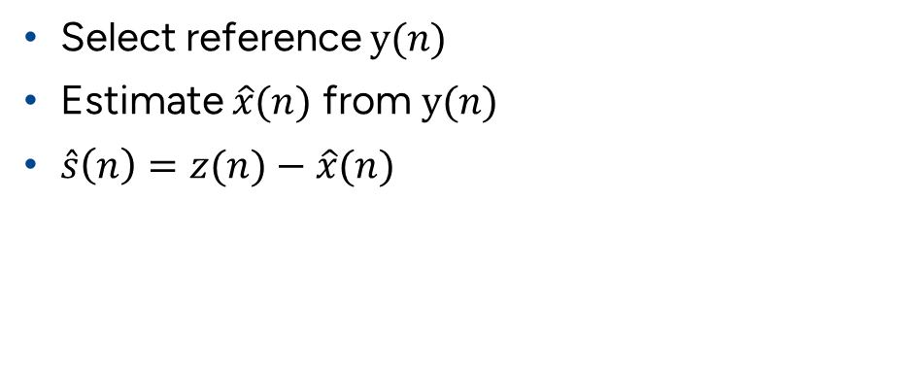
Task
Input: audio signal with tonal noise, $z\left(n\right)=s\left(n\right)+x(n)$
Target: employ LMS, NLMS, RLS
Problem: selection of reference $y(n)$
Select reference $y(n)$
Estimate $\hat{x}(n)$ from $y(n)$
$\hat{s}\left(n\right)=z(n)−\hat{x}(n)$

Slide 3
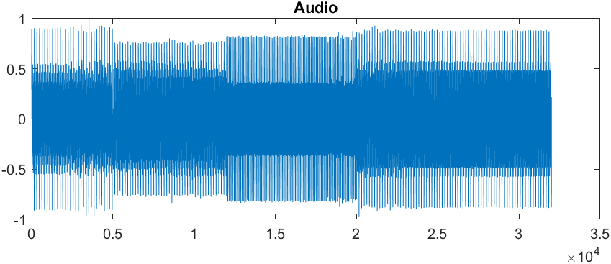
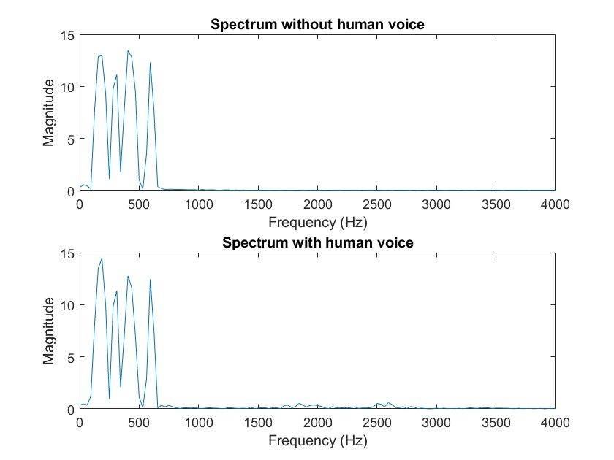
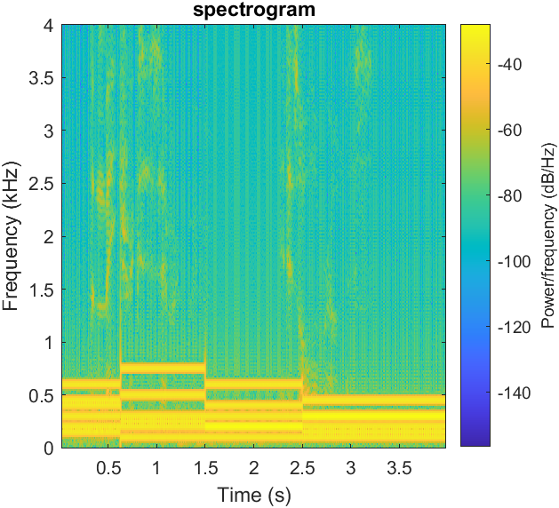
Signal and spectrum
Narrow-band noise
Noise with huge energy(>>speech signal)

Slide 4
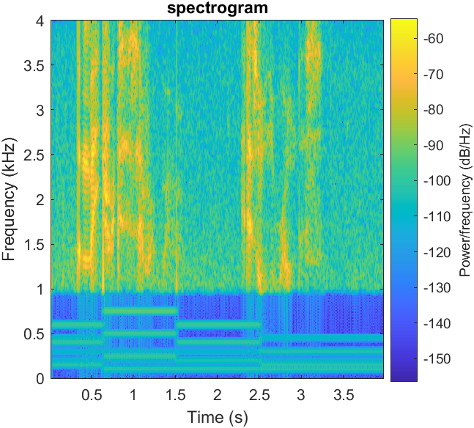
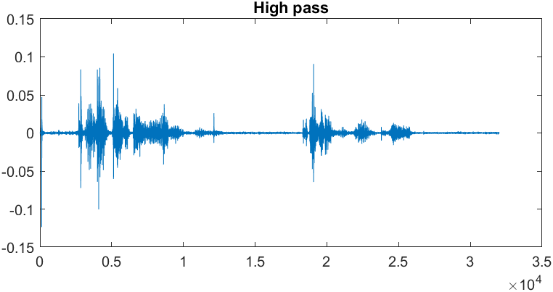
Intuitive idea
High pass filter
noise frequency is low, so a HPF would remove.
cut-off frequency fc = 1kHz

Slide 5
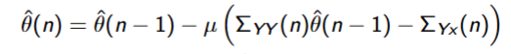
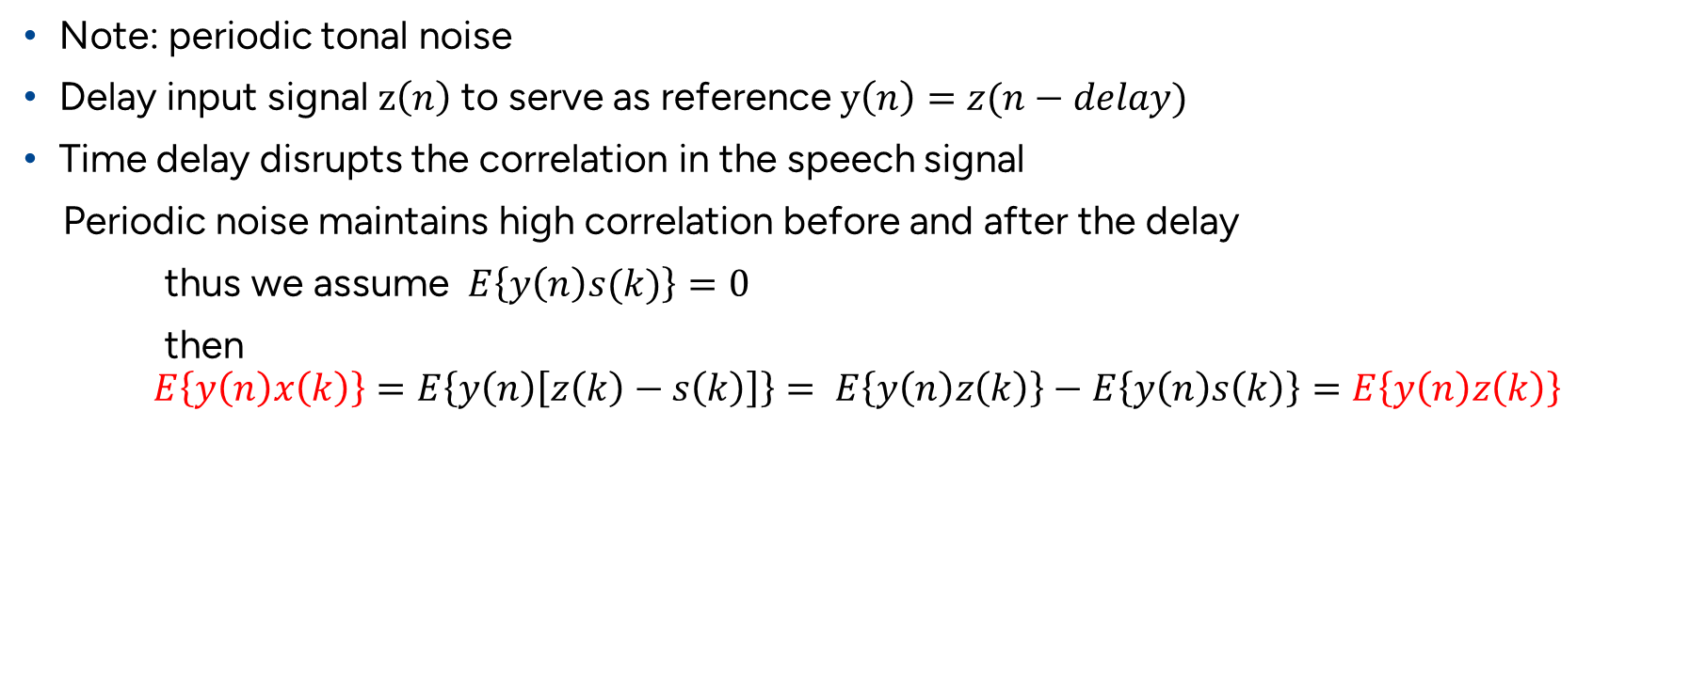
Adaptive Line Enhancer(ALE)
Note: periodic tonal noise
Delay input signal $z\left(n\right)$ to serve as reference $y\left(n\right)=z(n−delay)$
Time delay disrupts the correlation in the speech signal
Periodic noise maintains high correlation before and after the delay
thus we assume $E\left\{y\left(n\right)s(k)\right\}=0$
then
$$E\left\{y\left(n\right)x\left(k\right)\right\}=E\left\{y\left(n\right)\left[z\left(k\right)−s\left(k\right)\right]\right\}= E\left\{y\left(n\right)z\left(k\right)\right\}−E\left\{y\left(n\right)s\left(k\right)\right\}=E\left\{y\left(n\right)z\left(k\right)\right\}$$

Slide 6
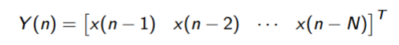
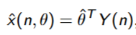
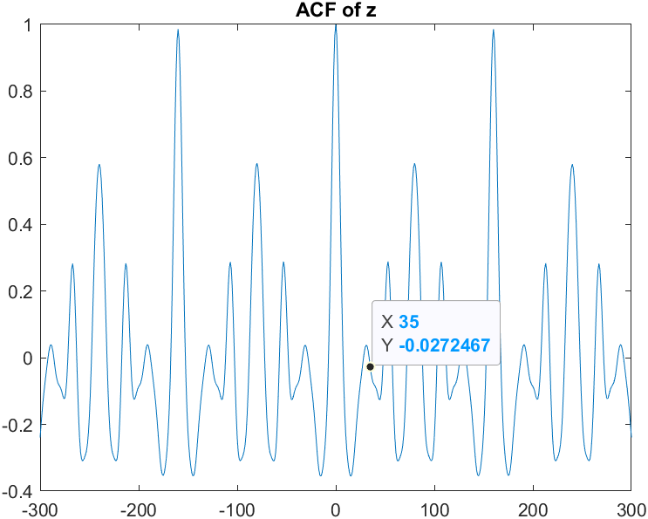
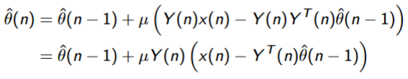
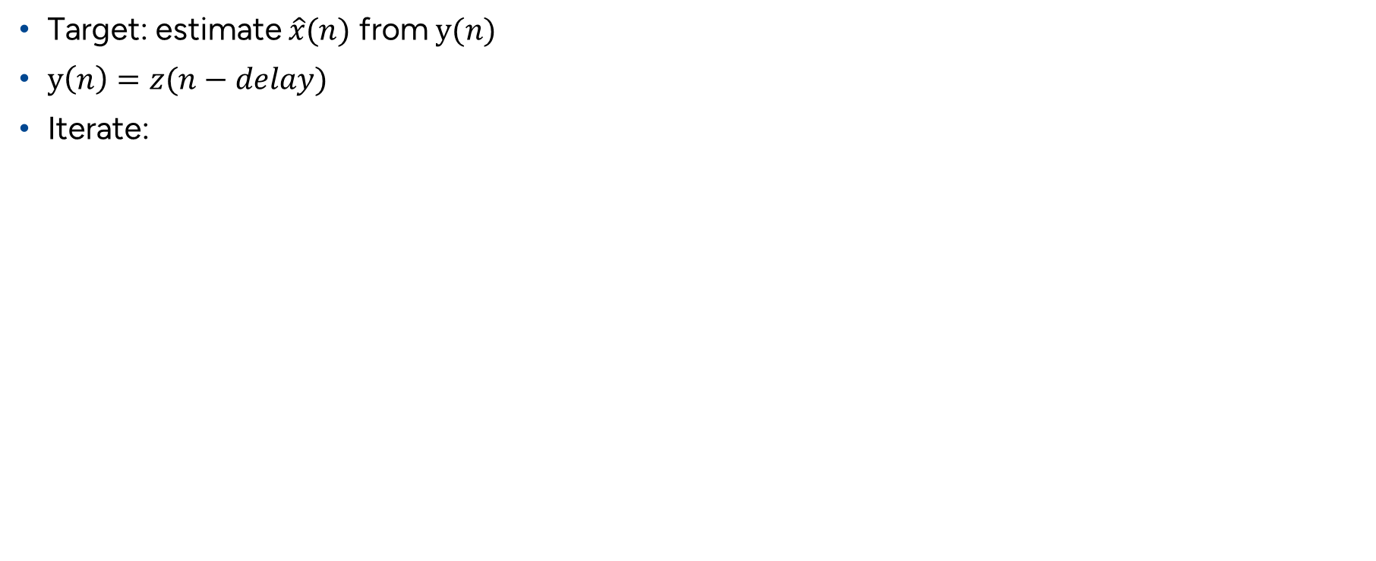
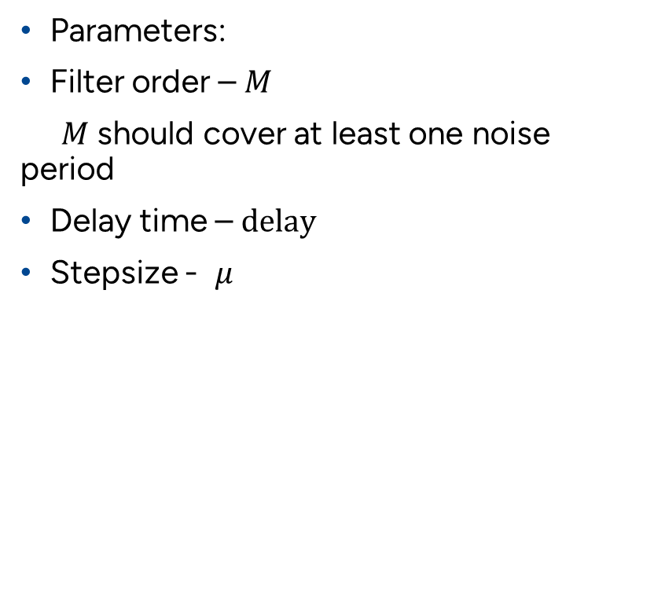
LMS
Parameters:
Filter order – $M$
$M$ should cover at least one noise period
Delay time – $delay$
Stepsize - $μ$
Target: estimate $\hat{x}(n)$ from $y(n)$
$y\left(n\right)=z(n−delay)$
Iterate:

Slide 7
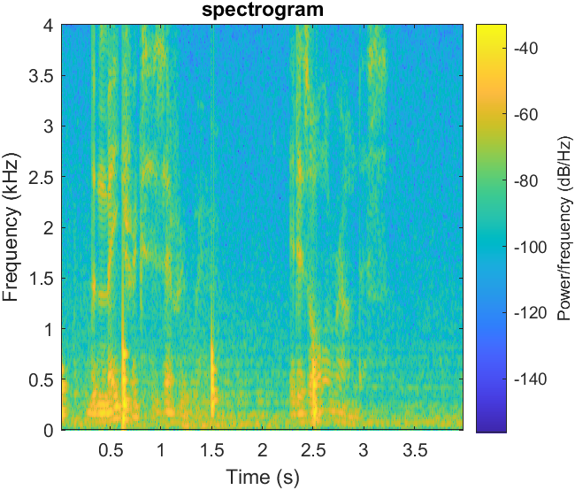
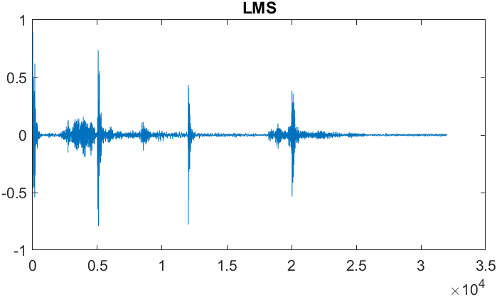
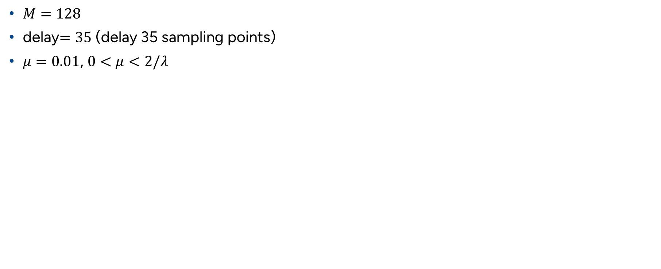
LMS results
$M=128$
delay$=35$ (delay 35 sampling points)
$μ=0.01$, $0<μ<2/λ$

Slide 8
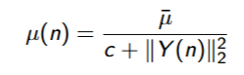
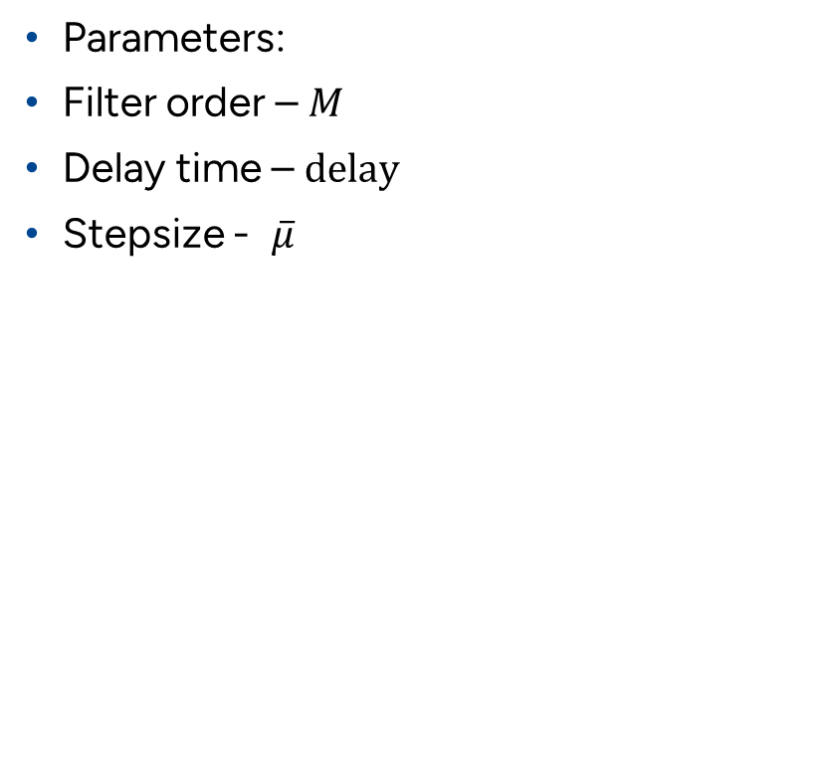
NLMS
Parameters:
Filter order – $M$
Delay time – $delay$
Stepsize - $\overline{μ}$
Update stepsize in each iteration
Iterate:

Slide 9
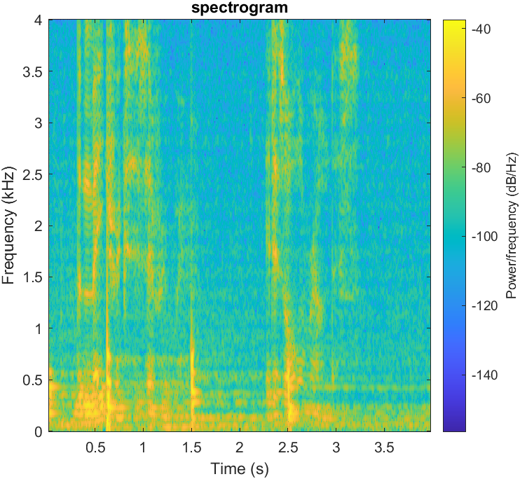
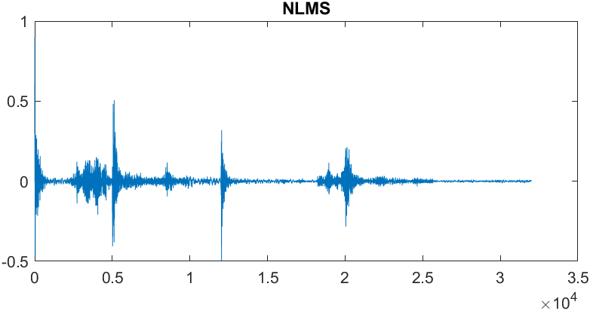

NLMS results
$M=128$
delay$=35$ (delay 35 sampling points)
$\overline{μ}=0.5$, $0<\overline{μ}<2$

Slide 10
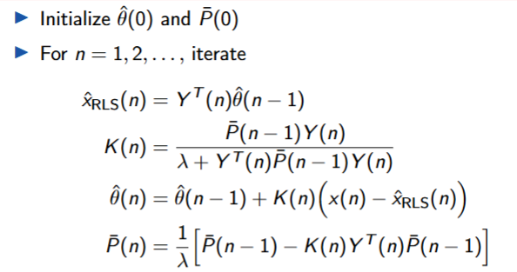
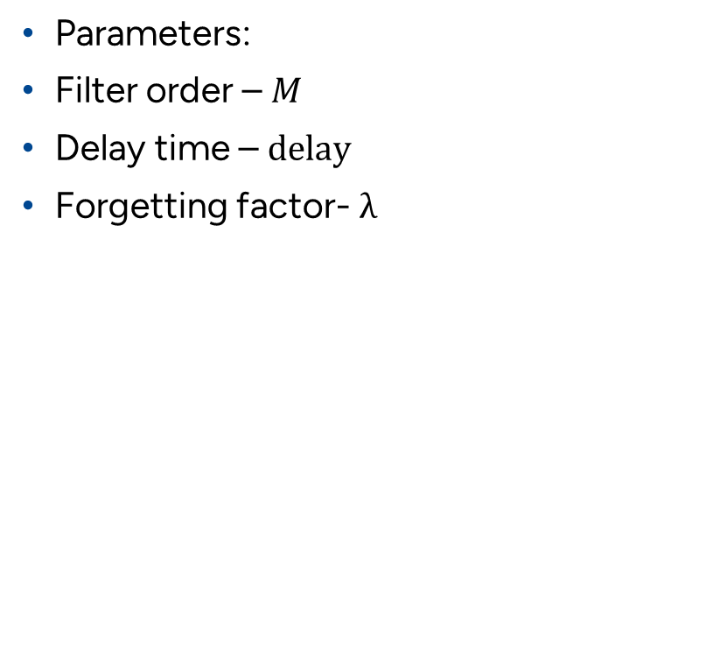
RLS
Parameters:
Filter order – $M$
Delay time – $delay$
Forgetting factor- $λ$

Slide 11
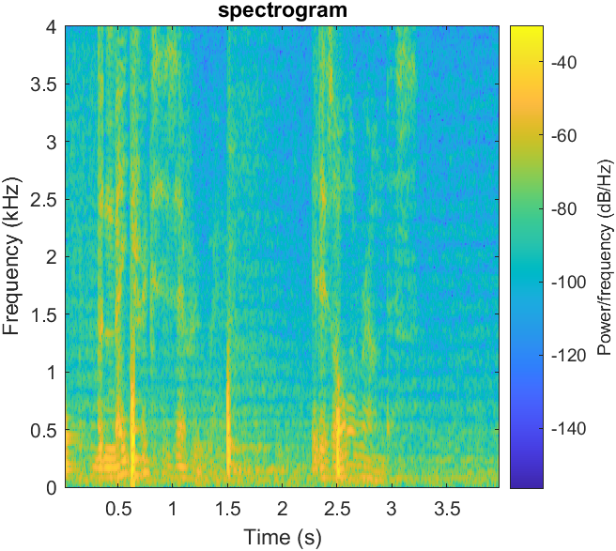
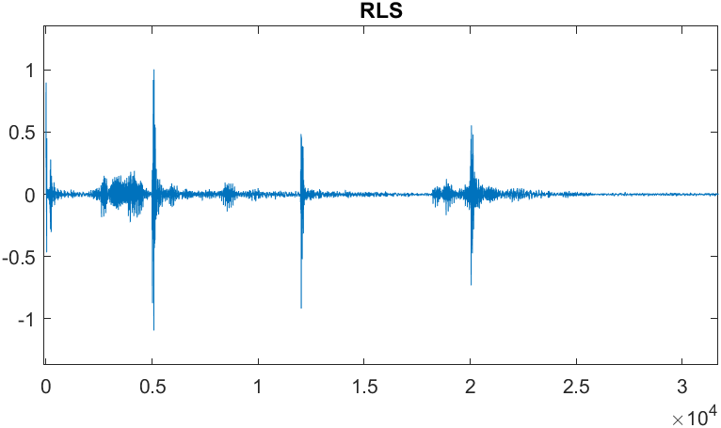

RLS results
$M=128$
delay$=35$ (delay 35 sampling points)
$λ=0.999$

